Slide 1

IoT final project – Cat project
Member: 鄭理文 王治皓

Slide 2
Background
Kitty litter box
Pee anywhere
Health
At home?

Slide 3
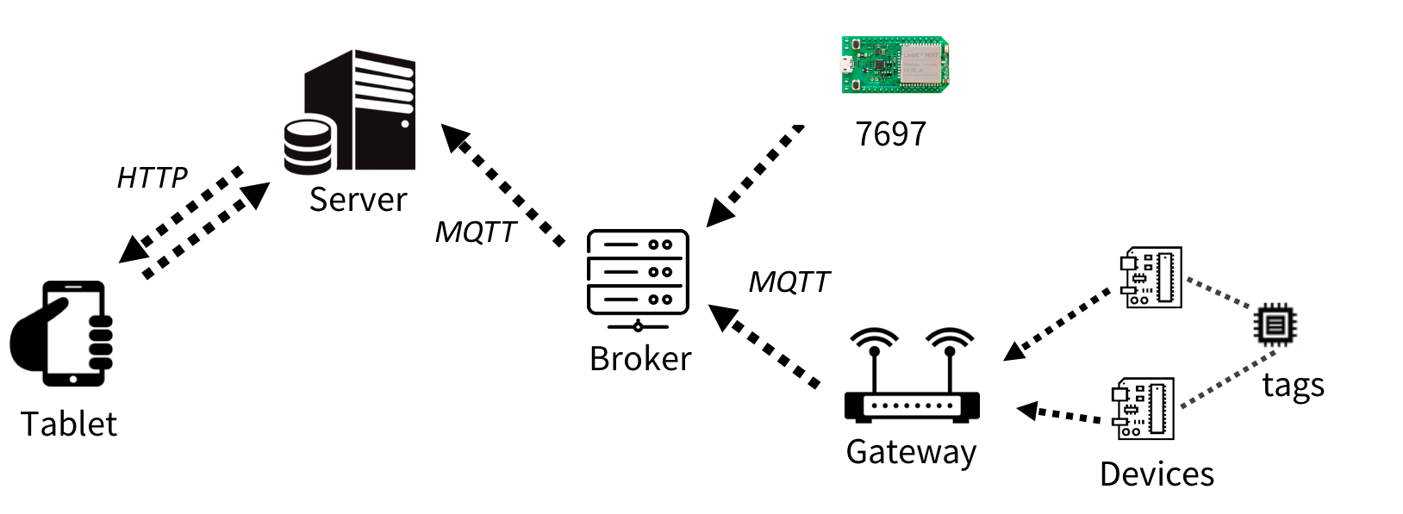
Architecture

Slide 4
Demo

